Slide 1
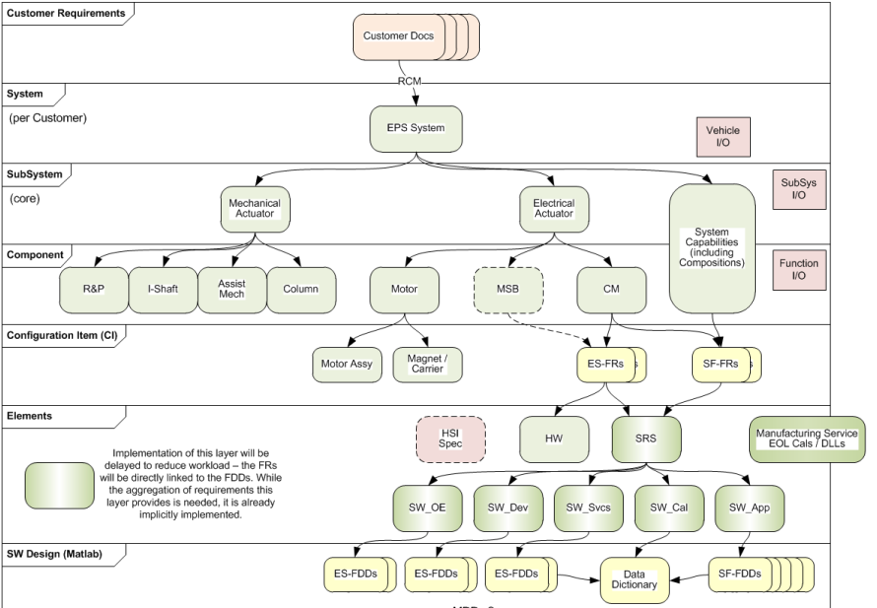
SE08 – System Architecture and Requirements Traceability
Description
Create processes and tools to support TDBU (Top down, bottom up) traceability
From customer requirements to system / subsystem / component
Motivation (Score: 12)
Required by ISO26262 / AutoSPICE
Required by multiple customers
Deliverables
Create GP-1385 (Customer Requirements Elicitation)
Create GP-1386 (Product Internal Requirements Allocation)
Include in CPI
Database (DOORS) architecture
Supporting analysis tools
Timing
Support PSA BMPV program roll-out
Team Members/Customers
Core Systems – Bill Wittig, Keith Marsh, Heidi Kowalski
App Systems – Geoff Krieger
Software – Keith Johnson, KPIT
Customer – BMW, GM, PSA, Fiat / Chrysler

Slide 2
SE08 – System Architecture and Requirements Traceability
Status
S&ES swimlanes added to CPI
GP1385 & 1386 in approval cycle
Challenges
Workload associated with populating missing requirements and adding traceability links
Training user community to use DOORS, especially in the pursuit phase
Imposition of a modular architecture on existing design
Next Steps
Write work instructions to support the process
Finalize database architecture
Implement tools
Parameter value auto-population in requirements documentation (as opposed to names only)
Traceability auditing tool

